Slide 1
Final Year Project
Presentation

Slide 2
MotorBike Karobar

Slide 3
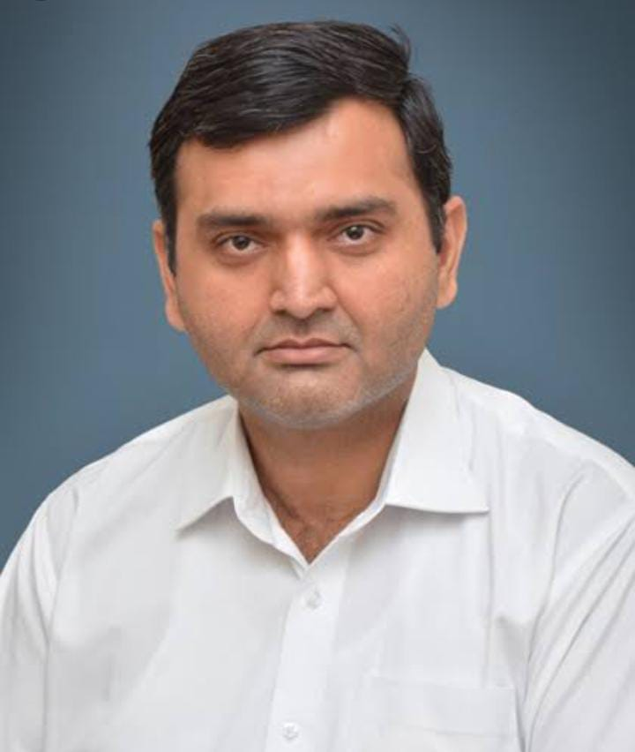
Project Supervisor
Prof. Saad Razzaq (HOD) Department of CS&IT

Slide 4
Team Members
Muhammad Asad Waqar (BSCS-F17-38) (Team Lead)
Saad Bin Aslam (BSCS-F17-E026) (Team Member)
Qaisar Shehzad

Slide 5
Abstract
There is no good digitally combined platform for selling and purchasing of new and used motorbikes, also for bike’s parts and accessories.
So, we want to take this business to digital world where users can search and navigate all about purchasing and selling their motorbikes and vice virsa, whether those are new or used.

Slide 6
Project Overview
There is some, actually I will say a lot of work has been done in this domain but there are lot of things which remains unnoticed and also those works are either very complex for local audience or this domain is a single limited option in some other big domain’s platform which is still a big problem
Like there are two big platforms which are working in this domain in Pakistan :

Slide 7
…
PAKWHEELS.COM is a big platform which is dealing with car business and motorbikes business. And their focus is mostly on cars. Basically divided focus and no system for any individual to sell bike. Also that platform is very complex for local audience and not good in design, in short very unattractive to navigate and spend time on that platform.
MOTORCYCLE SHOP is another platform which targets only motorbikes business which is good but there is no system for selling and purchasing of used bikes. Also no system for uploading other than platform’s owner or management. And also no system for any individual or workshop to grow their business on their own.

Slide 8
…
All other platforms are motorbikes official companies owners official websites which are limited and main thing is that not solving our problems.

Slide 9
Project Purpose
Main Objectives are the system is a reliable, secure and efficient . The system is available 24/7. Easy to use and friendly interface and this works with internet connectivity.
A website where you can do 90% of the work of this domain while sitting freely anywhere or while doing some other work
In this project we provide :
A website which allows users either they are common individuals or businessman to sell and purchase MotorBikes, parts & accessories by solving all problems they face nowadays. Those goods can be new or used.

Slide 10
Project Scope
Functionalities system will perform :
A seller side for uploading all required content with proper explanation
A navigate side for choosing the perfect item for the purchaser
A side to adjust your location
A side to manage the profile
A proper communication system to contact on both sides

Slide 11
Functionalities system will not perform :
MotorBike Karobar will not provide online transaction between two sides.
MotorBike Karobar will not provide pick and drop system.
MotorBike Karobar will not provide personal level legalities of purchaser & seller.

Slide 12
Functional Requirements
Login/Credentials
If its admin or a user, all must have to create their account and enter required data for further processing.
Name, Contact No, Email ,Residence
Selling Side for Bikes
A selling side for the users who want to sell. They will provide each and everything which a purchaser can demand.
For selling, they must have to upload enough information like :
Bike’s condition, Engine Condition, Old or New, Company’s Name, Price, Chassis Number.

Slide 13
…
Selling Side for Bikes parts/Accessories
People who wants to sell the Bikes parts & accessories can easily post their content here , with all standard information a user can demand
Purchasing Side
A purchasing side for the users who want to navigate and purchase. Everything must be visible according to location.
They can navigate throughout the page to purchase what they actually need. Also they can search the perfect item they needed

Slide 14
…
Purchasing Side for Bikes parts/Accessories
People who wants to purchase the Bikes parts & accessories can easily navigate here and purchase according to their need
Location
On this side user can adjust their location for location oriented services

Slide 15
…
Contact
A contact side where users can communicate with each other for buying or purchasing means.
Review/Feed
Here buyers or purchaser can give reviews and feeback regarding theoverall system and its functionalities

Slide 16
…
Security/Queries
Owner handles the security concerns by keeping him up to date
Owner handle queries given by users
Update system/Maintain Website
Owner keeps the system up to date
Owner maintains overall websites functionality and features

Slide 17
…
Update database
Owner will manage all the database of users either they are buyer or seller
Owner will update the database schemas

Slide 18
Assumptions and Dependencies
MotorBike Karobar makes multiple assumptions and dependencies with users, some are
First of all everyone must have internet connection
They must have Android, IOS or the windows running device with browser installed in itproperly
They must have to make a profile to use the website

Slide 19
Risks and Volatile Areas
The design structure of our system is very flexible. We can easily add a new module in the existing system. The risks which can occur in the system are following :
Fake account can cause of misguidance
Any software and hardware failure can occur
Any intruders like hackers can affects our system
Database may crash
Server can be down

Slide 20
Thank You !

